Slide 1

Verification and Validation of Safety and Security Requirements In Autonomous Vehicle
ECE 5734- Embedded System Verification & Validation
Project Progress
Presented By
Cory Ness
Kokila Subramanian
Under the Guidance of
Professor Ramesh Sethu

Slide 2
Objective
To develop an autonomous Vehicle model based on physics that simulate sensors for velocity & distance measurement, lane centring for cruise control using LabVIEW simulation tool.
To identify, verify and validate the functional requirements of the Autonomous vehicle model with respect to safety and security metrics defined reliant on SAE Automation Levels.
Safety requirement analysis is made based on hazard analysis, lane control, automatic braking system and accidental failures.
Security requirements are analysed based on the threat and risk assessments

Slide 3
Safety Requirements
Dynamic Driving Conditions
Increase and decrease the speed of the vehicle based on the driving and traffic conditions
Ensure Controllability of Vehicle
Determine the Good Acceleration and Turn thresholds that maintains stability of the vehicle
Collision Free and Law Full driving plan
Identify obstacles in path and perceive the position of surrounding objects
Execute and Actuate right driving plan
Combine the driving plan and Egomotion to control motion actuators
Dynamic Lane Merge System
Perform lateral control to maintain lane and execute seamless lane change

Slide 4
Test Cases for Verification of Safety Requirements
1. Drive straight ahead at 60MPH
2. Speed Up and Speed down
3. Stability of vehicle at 360° turn
4. Unsafe Real-Time Driving case
5. Obstacle Detection
6. Lane control & Seamless Lane Merge

Slide 5
Model Based Autonomous Vehicle Control Design Car Simulation Model – Block Diagram

Slide 6
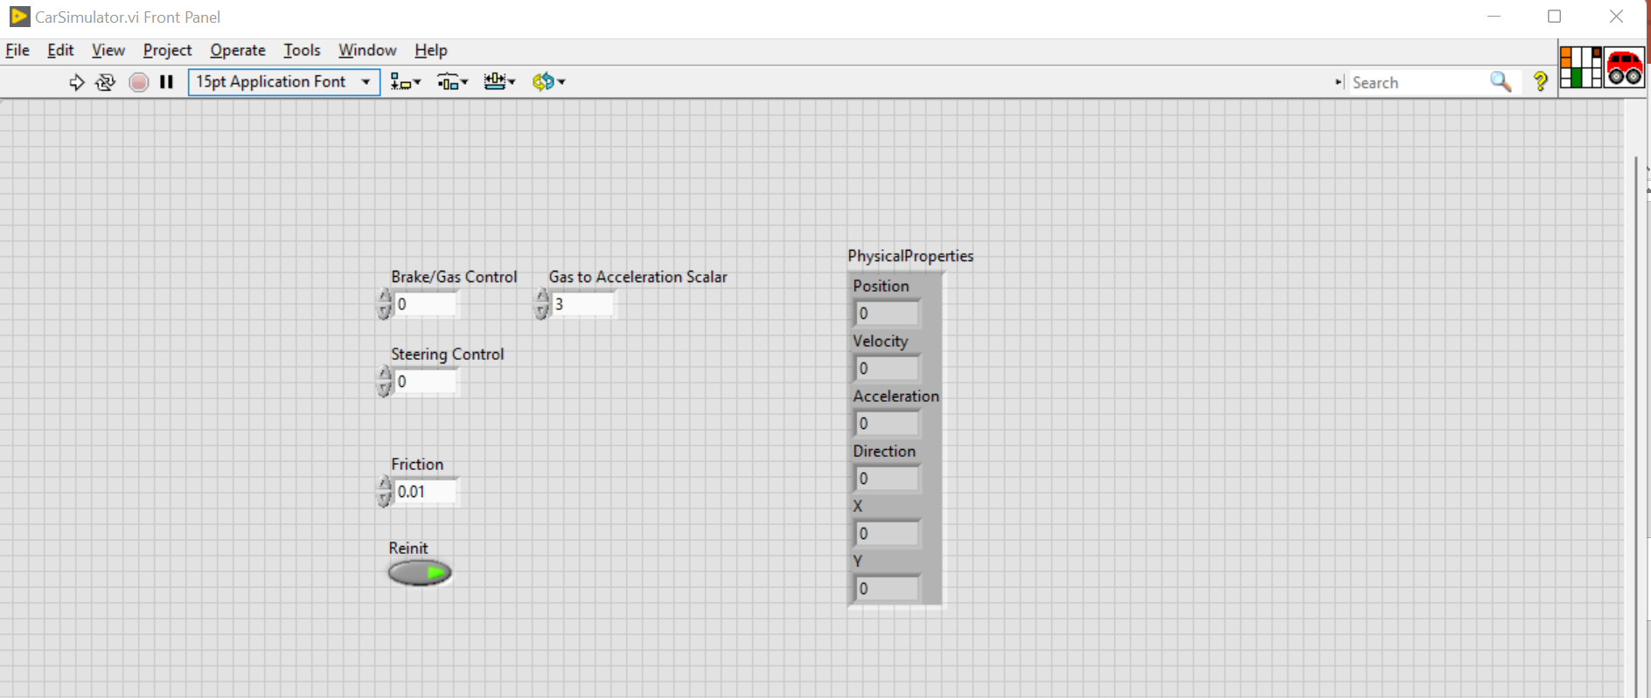
Car simulation Model- Block Diagram

Slide 7
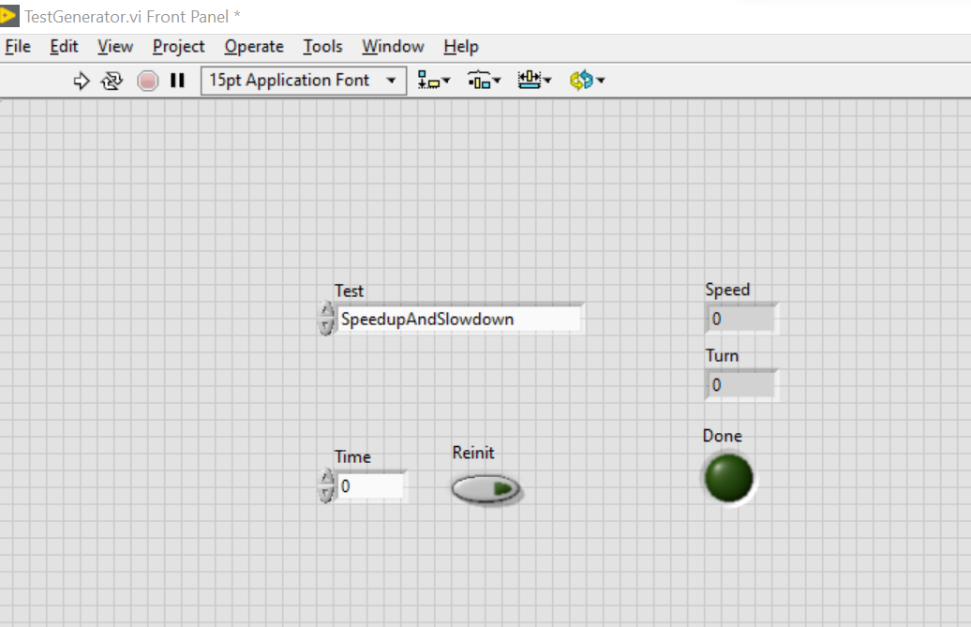
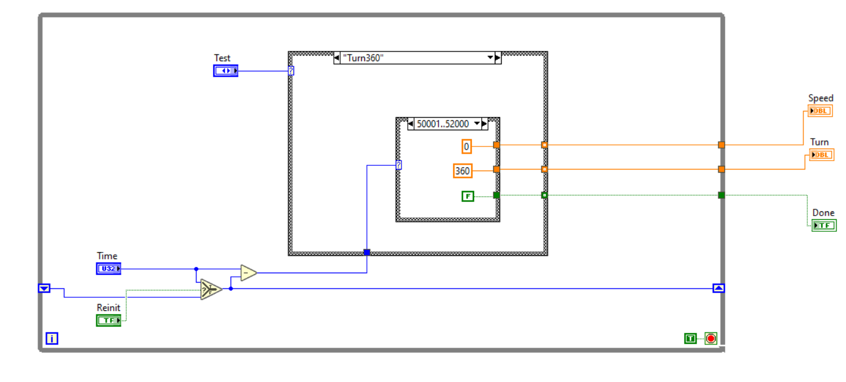
Test Generator

Slide 8
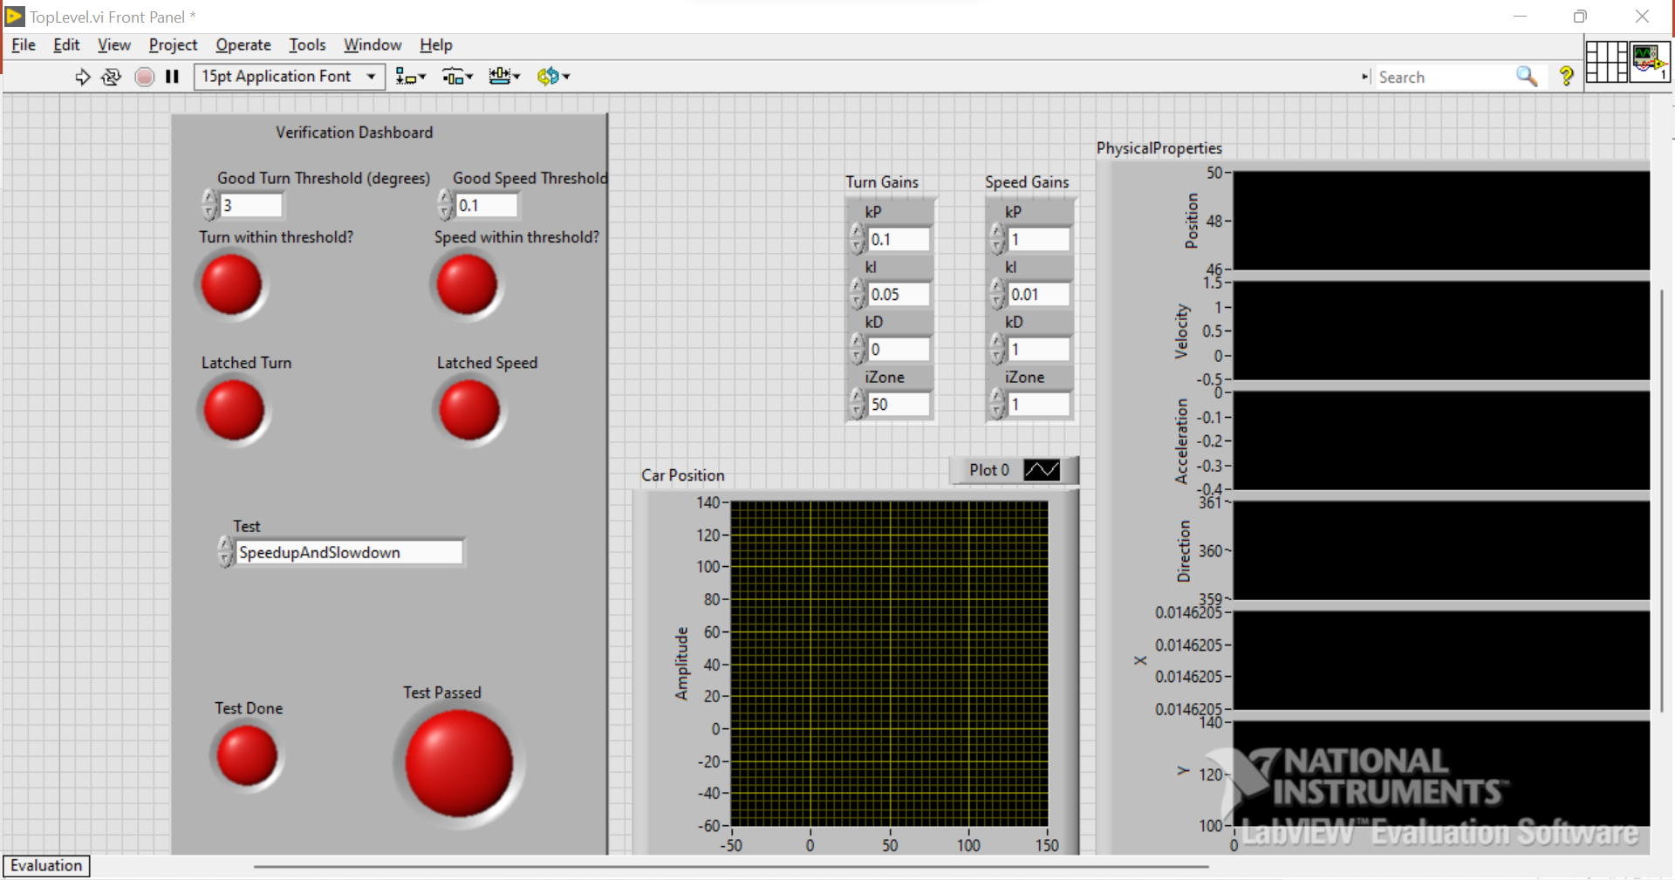
Top Level- Verification Dashboard

Slide 9
Drive Straight Ahead at 60 MPH

Slide 10
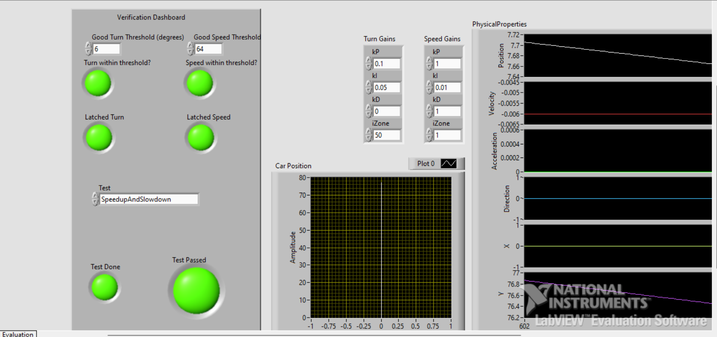
Speed up and Speed Down Test

Slide 11
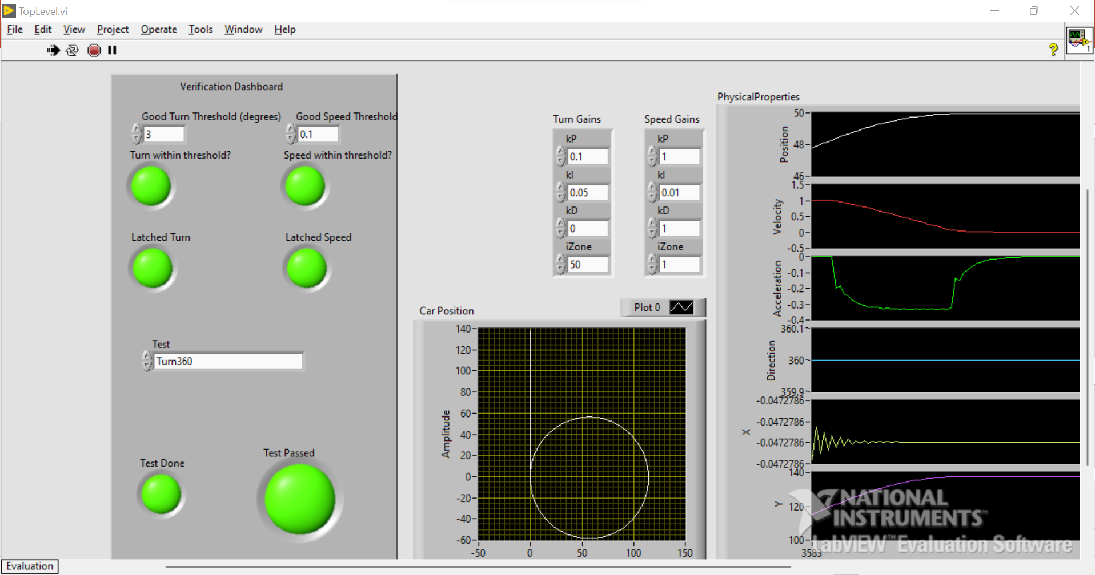
Turn 360° Test

Slide 12
Unsafe Real-Time Driving Test

Slide 13
V & V of Threshold Values
Test Case | Threshold values |  | Test Passed |  | Test Failed
 | Speed | Turn Angle | Speed | Turn Angle | Speed | Turn Angle
Drive straight ahead at 60 MPH
Speed Up and Speed Down
Turn 360°
Unsafe Real-time Driving

Slide 14
References
Ailon, A., Berman, N., & Arogeti, S. (2005). On controllability and trajectory tracking of a kinematic vehicle model. Automatica, 41(5), 889–896. https://doi.org/10.1016/j.automatica.2004.11.025
Benz: Safety First for automated driving. Mercedes. (2019, July 4). https://www.mercedes-benz.com/en/innovation/safety-first-for-automated-driving/?csref=sm_fbk_gims2019_pc.html
Kang, C. M., Lee, S.-H., & Chung, C. C. (2018). Multirate Lane-keeping system with kinematic vehicle model. IEEE Transactions on Vehicular Technology, 67(10), 9211–9222. https://doi.org/10.1109/tvt.2018.2864329
Kong, G., Pfeiffer, Mark., Schildbach, G., and Borrelli, F. Kinematic and dynamic vehicle models for Autonomous Driving Control Design. IEEE Xplore. (n.d.). https://ieeexplore.ieee.org/document/7225830
Sabaliauskaite, G., Liew, L., & Cui, J. (1970, January 1). [PDF] Integrating Autonomous Vehicle Safety and security analysis using STPA method and the six-step model: Semantic scholar. undefined. https://www.semanticscholar.org/paper/Integrating-Autonomous-Vehicle-Safety-and-Security-Sabaliauskaite-Liew/dcc9ab963f2f4d97b5dc81d0e8df0708008d36a8

